Slide 1
Intro to Java (Page 8)
JUMP June 2019
Draft: 07/24/2019

Slide 2
Table of Contents
JavaFX

Slide 3
JavaFX
Intro
Swing vs JavaFX
JavaFX Packages
The Stage and Scene Classes
Nodes and Scene Graphs
Layouts
The Application Class and the Life-cycle Methods
Launching a JavaFX application
STS and JavaFX Settings
“Hello World” JavaFX Style!
The story of 2 buttons and a label
2 Buttons, a Label and some Alignment
Let’s Draw!
Smarter Event Handling
Control Demos

Slide 4
JavaFX - Intro
JavaFX is designed as a replacement for Swing
Swing will be part of Java programming for some time to come because of the large amount of legacy code.
JavaFX is positioned as the platform of the future.
In the next few years, JavaFX will supplant Swing for new projects.
Many Swing-based applications will migrate to JavaFX.
https://docs.oracle.com/javase/8/javafx/get-started-tutorial/jfx-overview.htm
Starting with JDK11, JavaFX is now available as a separate package.

Slide 5
JavaFX – Swing vs JavaFX
While JavaFX has similarities with Java’s other GUIs, the AWT and Swing, it has substantial differences.
Similarities
Like Swing, JavaFX components are lightweight and events are handled in an easy-to-manage, straightforward manner.
Differences
The overall organization of JavaFX and the relationship of its main components differ significantly from either Swing or the AWT.

Slide 6
JavaFX – Java FX Packages
The JavaFX framework is contained in packages that begin with the javafx prefix.
There are more than 30 JavaFX packages in its API library.
Here are four examples:
javafx.application.Application;
javafx.stage.Stage;
javafx.scene.layout.StackPane;
javafx.scene.Scene;
We will only use a few JavaFX packages in this session, enough to give you a good foundation on how to use JavaFX and further your education should the need arise.

Slide 7
JavaFX – The Stage and Scene Classes
Central to JavaFX's core architecture is the concept and implementation of stage and scene.
All JavaFX apps must have at least one stage and that stage must contain at least one scene.
These elements are encapsulated in the JavaFX API by the Stage and Scene classes.
Stage is a top-level container.
All JavaFX applications automatically have access to one Stage, called the primary stage.
The primary stage is supplied by the run-time system when a JavaFX application is started.
Although you can create other stages, for many applications, the primary stage will be the only one required.
Scene is a container for the items that comprise the scene.
These can consist of controls, such as push buttons and check boxes, text, and graphics.
To create a scene, you will add those elements to an instance of Scene.

Slide 8
JavaFX – Nodes and Scene Graphs
The individual elements of a scene are called nodes. For example, a push button control is a node.
However, nodes can also consist of groups of nodes.
Furthermore, a node can have a child node.
In this case, a node with a child is called a parent node or branch node.
Nodes without children are terminal nodes and are called leaves.
The collection of all nodes in a scene creates what is referred to as a scene graph, which comprises a tree.
There is one special type of node in the scene graph, called the root node.
This is the top-level node and is the only node in the scene graph that does not have a parent.
With the exception of the root node, all other nodes have parents, and all nodes either directly or indirectly descend from the root node.
The base class for all nodes is Node. There are several other classes that are, either directly or indirectly, subclasses of Node.
These include Parent, Group, Region, and Control, to name a few…

Slide 9
JavaFX – Layouts
JavaFX provides several layout panes that manage the process of placing elements in a scene.
The FlowPane class provides a flow layout and the GridPane class supports a row/column grid-based layout.
Several other layouts, such as BorderPane (which is similar to the AWT’s BorderLayout), are available.
Each inherits Node. The layouts are packaged in javafx.scene.layout.

Slide 10
JavaFX – The Application Class and the Life-cycle Methods
A JavaFX application must be a subclass of the Application class, which is packaged in javafx.application.
Your application class will extend Application.
The Application class defines three life-cycle methods that your application can override.
These are called init( ), start( ), and stop( ), and they are called in the order presented.

Slide 11
JavaFX – Launching a JavaFX application
To start a free-standing JavaFX application, you must call the launch( ) method defined by Application.
public static void launch(String … args)
Here, args is a possibly empty list of strings that typically specify command-line arguments.
When called, launch( ) causes the application to be constructed, followed by calls to init( ) and start( ).
The launch( ) method will not return until after the application has terminated.
The launch( ) method starts the subclass of Application from which launch( ) is called.

Slide 12
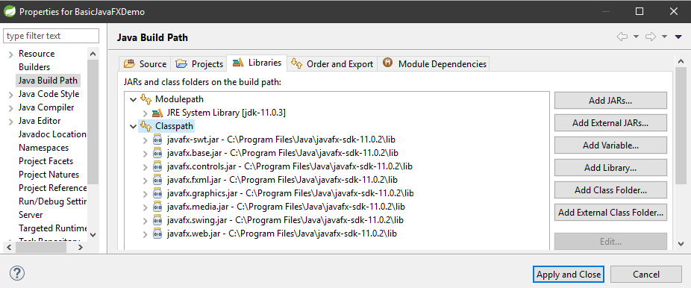
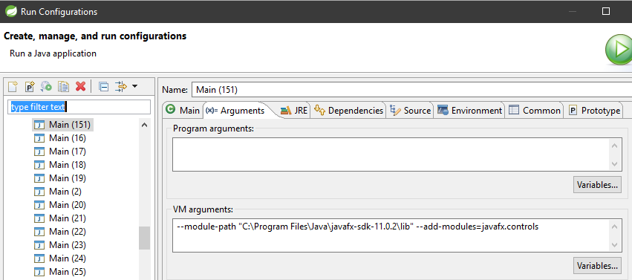
JavaFX – STS and JavaFX Settings
1) Download Link
2) When ready to use it in any given project
Create a Java Project (STS)
Right-click on project (access Properties)
Locate Java Build Path
Click the Libraries tab, Select the Classpath folder
Click Add external JARs
Locate the javafx-sdk-11.0.2\lib folder
add all JARs from the lib folder
Apply and Close
Link to SDKs https://gluonhq.com/products/javafx/
Download Java FX (SDK) version 11.0.2 (public version)
Unzip the SDK somewhere you can refer to (notice it will have a javafx-sdk-11.0.2\lib folder
There are several versions depending on OS. (do not download jmods)*
3) Run Configurations - Arguments - VM Options for STS in Windows
--module-path "C:\Program Files\Java\javafx-sdk-11.0.2\lib" --add-modules=javafx.controls
*For those curious about jmods file format: https://stackoverflow.com/questions/44732915/why-did-java-9-introduce-the-jmod-file-format

Slide 13
JavaFX – “Hello World” JavaFX Style!
Launch() from Application
public class Main extends Application {
public static void main(String[] args) {
launch(args);
}
public void init() {
System.out.println("init() method called first.");
}
public void start(Stage primaryStage) {
System.out.println("start() method called second.");
primaryStage.setTitle("Hello World!");
Button btn = new Button();
btn.setText("Say 'Hello World'");
btn.setOnAction(new EventHandler<ActionEvent>() {
public void handle(ActionEvent event) {
System.out.println("Hello World!");
}
});
StackPane root = new StackPane();
root.getChildren().add(btn);
primaryStage.setScene(new Scene(root, 300, 250));
primaryStage.show();
}
public void stop() {
System.out.println("stop() method called last when app is closed.");
}
}
Method init()
Method start()
Method stop() when window is closed
import javafx.application.Application;
import javafx.stage.Stage;
import javafx.scene.control.Button;
import javafx.event.EventHandler;
import javafx.event.ActionEvent;
import javafx.scene.layout.StackPane;
import javafx.scene.Scene;
In this demo, we have a Hello World panel with an interactive Button
We also get to witness the full lifecycle of the app.
The method stop() will execute when we close the app.
See live code in STS “BasicJavaFXDemo”

Slide 14
JavaFX – The story of 2 buttons and a label
myLabel
public class Main extends Application {
public void start(Stage primaryStage) {
primaryStage.setTitle("2 Buttons and a Label");
Label myLabel = new Label("");
Button btn = new Button();
btn.setText("Say 'Hello World'");
Button btn2 = new Button();
btn2.setText("Reset");
btn.setOnAction(new EventHandler<ActionEvent>() {
public void handle(ActionEvent event) {
myLabel.setText("hello world!");
}
});
btn2.setOnAction(new EventHandler<ActionEvent>() {
public void handle(ActionEvent event) {
myLabel.setText("");
}
});
VBox vbox = new VBox(btn, myLabel, btn2);
Scene scene = new Scene(vbox, 200, 100);
primaryStage.setScene(scene);
primaryStage.show();
}
}
Button btn and btn2
Each have their action
Vbox layout
import javafx.application.Application;
import javafx.stage.Stage;
import javafx.scene.control.*;
import javafx.event.EventHandler;
import javafx.event.ActionEvent;
import javafx.scene.layout.VBox;
import javafx.scene.Scene;;
In this demo, we have a label being controlled by 2 buttons
See live code in STS “BasicJavaFXDemo2”

Slide 15
JavaFX – 2 Buttons, a Label and some Alignment
public class Main extends Application {
Label response;
…
public void start(Stage myStage) {
myStage.setTitle("JavaFX Buttons, Events and Alignment");
FlowPane rootNode = new FlowPane(10, 10);
rootNode.setAlignment(Pos.CENTER);
Scene myScene = new Scene(rootNode, 300, 100);
myStage.setScene(myScene);
response = new Label("Push a Button!");
Button btnAlpha = new Button("Alpha");
Button btnBeta = new Button("Beta");
btnAlpha.setOnAction(new EventHandler<ActionEvent>() {
public void handle(ActionEvent ae) {
response.setText("Alpha was pressed.");
}
});
btnBeta.setOnAction(new EventHandler<ActionEvent>() {
public void handle(ActionEvent ae) {
response.setText("Beta was pressed.");
}
});
rootNode.getChildren().addAll(btnAlpha, btnBeta, response);
myStage.show();
}
}
FlowPane with HGap and VGap
Geometry.Pos.CENTER
addAll()
import javafx.application.Application;
import javafx.stage.Stage;
import javafx.scene.control.*;
import javafx.event.EventHandler;
import javafx.event.ActionEvent;
import javafx.scene.layout.FlowPane;
import javafx.scene.Scene;
import javafx.geometry.*;
Similar to the previous demo, but with better layout control.
See live code in STS “BasicJavaFXDemo3”

Slide 16
JavaFX – Let’s Draw!
public class Main extends Application {
GraphicsContext gc;
Color[] colors = { Color.RED, Color.BLUE, Color.GREEN, Color.BLACK};
int colorIdx = 0;
…
public int getRandom(int max){
return (int) (Math.random()*max);
}
public void start(Stage myStage) {
myStage.setTitle("Draw Directly to a Canvas.");
FlowPane rootNode = new FlowPane();
rootNode.setAlignment(Pos.CENTER);
Scene myScene = new Scene(rootNode, 450, 450);
myStage.setScene(myScene);
Canvas myCanvas = new Canvas(400, 400);
gc = myCanvas.getGraphicsContext2D();
Button btnChangeColor = new Button("Change Color");
btnChangeColor.setOnAction(new EventHandler<ActionEvent>() {
public void handle(ActionEvent ae) {
colorIdx = getRandom(colors.length);
gc.setStroke(colors[colorIdx]);
colorIdx = getRandom(colors.length);
gc.setFill(colors[colorIdx]);
gc.strokeLine(0, 0, 200, 200);
gc.fillText("This is drawn on the canvas.", 60, 50);
gc.fillRect(100, 320, 300, 40);
}
});
gc.strokeLine(0, 0, 200, 200);
gc.strokeOval(100, 100, 200, 200);
gc.strokeRect(0, 200, 50, 200);
gc.fillOval(0, 0, 20, 20);
gc.fillRect(100, 320, 300, 40);
gc.setFont(new Font("Arial", 14.0));
gc.fillText("This is drawn on the canvas.", 60, 50);
rootNode.getChildren().addAll(myCanvas, btnChangeColor);
myStage.show();
}
}
Graphic Context 2D = Canvas
Various Ways of Drawing
import javafx.application.*;
import javafx.scene.*;
import javafx.stage.*;
import javafx.scene.layout.*;
import javafx.scene.control.*;
import javafx.event.*;
import javafx.geometry.*;
import javafx.scene.shape.*;
import javafx.scene.canvas.*;
import javafx.scene.paint.*;
import javafx.scene.text.*;
Similar to the previous demo, but with better layout control.
JavaFX’s graphics methods are found in the GraphicsContext class, which is part of java.scene.canvas.
To obtain a GraphicsContext that refers to a canvas, call getGraphicsContext2D( ).
See live code in STS “BasicJavaFXDemo4”
Curious about AWT and Swing? https://www.oracle.com/technetwork/java/painting-140037.html

Slide 17
JavaFX – Smarter Event Handling
public class Main extends Application {
…
public void myHandle(Button btn) {
String id = btn.getId();
switch(id) {
case "changeColor":
colorIdx = getRandom(colors.length);
gc.setStroke(colors[colorIdx]);
colorIdx = getRandom(colors.length);
gc.setFill(colors[colorIdx]);
gc.fillText("This is drawn on the canvas.", 60, 50);
gc.fillRect(100, 320, 300, 40);
default:
System.out.println("Button Id = " + id);
break;
}
}
public void start(Stage myStage) {
…
Button btnChangeColor = new Button("Change Color");
btnChangeColor.setId("changeColor");
Button btnTest = new Button("Test Button");
btnTest.setId("Test");
btnChangeColor.setOnAction(new EventHandler<ActionEvent>() {
public void handle(ActionEvent ae) {
myHandle((Button) ae.getSource());
}
});
btnTest.setOnAction(new EventHandler<ActionEvent>() {
public void handle(ActionEvent ae) {
myHandle((Button) ae.getSource());
}
});
…
}
}
One Method for Handling Event
Setting Up IDs
Casting of Button
import javafx.application.*;
import javafx.scene.*;
import javafx.stage.*;
import javafx.scene.layout.*;
import javafx.scene.control.*;
import javafx.event.*;
import javafx.geometry.*;
import javafx.scene.canvas.*;
import javafx.scene.paint.*;
import javafx.scene.text.*;
Similar to the previous demo, demonstrating how we can create better event handlers.
Basically, we can set up IDs for our buttons
And we can create easy scaffolding of the setOnAction
We also could have easily enough created lambdas for this.
See live code in STS “BasicJavaFXDemo5”

Slide 18
JavaFX – Control Demos
Demo | Folder
Loading an Image | BasicJavaFXLoadImage
Label and Image Combo | BasicJavaFXImageLabel
Button and Image Combo | BasicJavaFXButtonImage
Toggle Button | BasicJavaFXToggleButton
Radio Button | BasicJavaFXRadioButton
CheckBox | BasicJavaFXCheckBox
ListView | BasicJavaFxListView
ComboBox | BasicJavaFxComboBox
TextField | BasicJavaFxTextField
ScrollPane | BasicJavaFxScrollPane
TreeView | BasicJavaFxTreeView
GridPane | BasicJavaFxGridPane
Special Effects | BasicJavaFXSpecialEffects

Slide 19
JavaFX – Sample App
A JavaFX Sample App
Case Study: Given what we've learned so far….
See live code in STS “JavaFX…”

